Slide 1
Networks and Systems Security 2 CSE 354/554 Instructor: Sambuddho
(Semester: Winter 2025)
Week 4: Jan 27 -- 30

Slide 2
Network Reconnaissance
First step in analyzing network security setup.
Determine the available services (open ports), OS versions etc.
Popular applications – port scanning – searching for open services.
Nmap –
- Popular open source network reconnaissance scanner.
Works by sending crafted TCP packets to known ports to check for availability.
Sequence of received packets are used to determine the availability AS WELL AS OS version numbers.

Slide 3
Nmap/Zenmap
- Half open SYN scan
- Send TCP SYN message to a host:port.
- If service is running (port listening) is up then you should get back a valid TCP SYN+ACK.
- If host up but no service running the you should get a RST+ACK.
Response varies as per OS
nmap –sS 192.168.2.3
nmap –A –p- -T4 192.168.2.3
- If host not up or behind a firewall: Response ‘filtered’

Slide 4
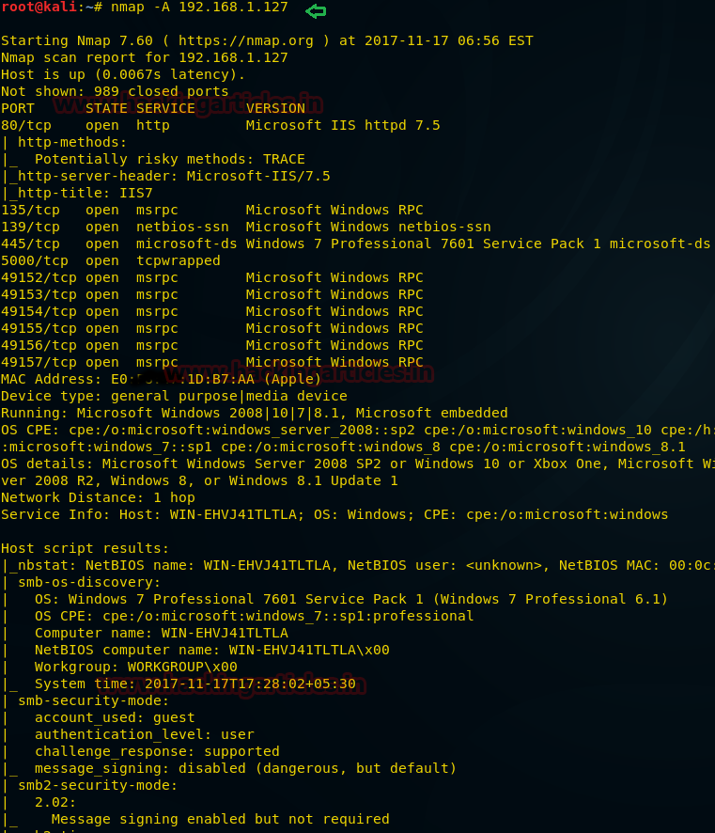
Nmap complete scan

Slide 5
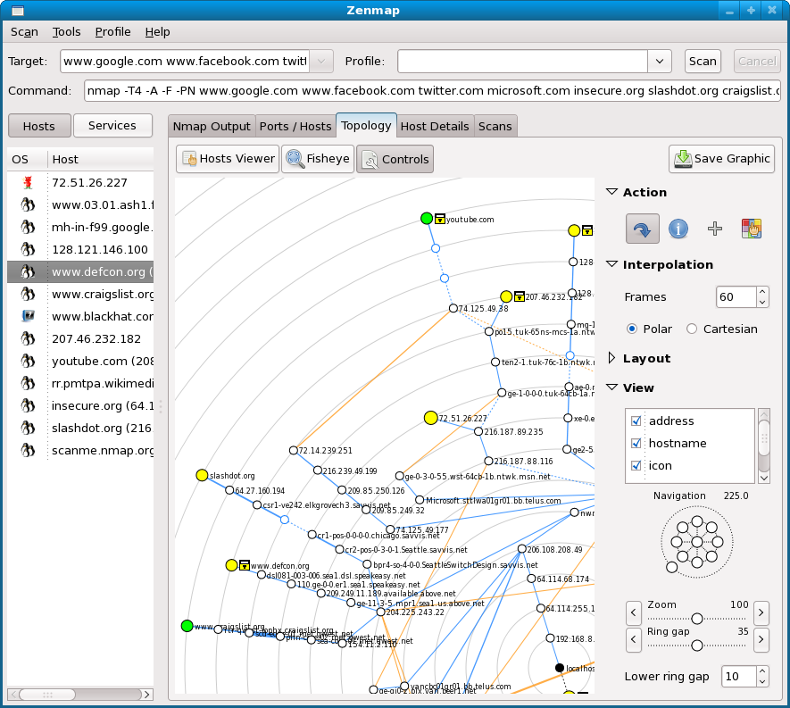
Zenmap: GUI Based Platform for Nmap

Slide 6
Network Reconnaissance
Purpose and benefits for attackers:
-Used as the first and most important tool in network vulnerability assessment and audit.
-Is often used by botmasters and bots to discover open vulnerable services and hosts.
-Port scanning, checking for open networks, networks which do not broadcast SSIDs (hidden APs), discovering the OSes and their versions.

Slide 7
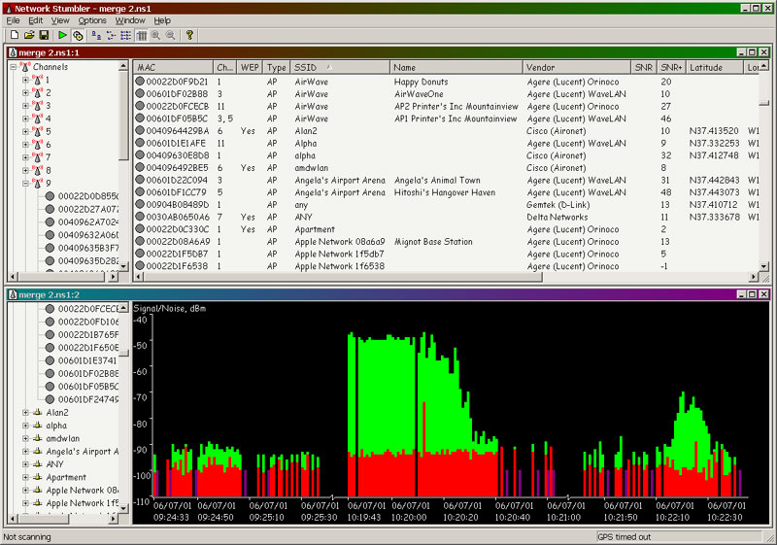
Other Network Discovery Tools
-Netstumbler
-Fing
-Cheops-NG

Slide 8
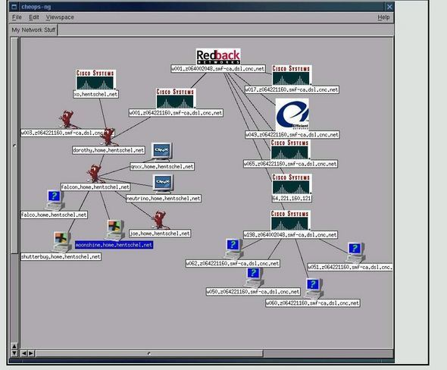
Other Network Discovery Tools

Slide 9
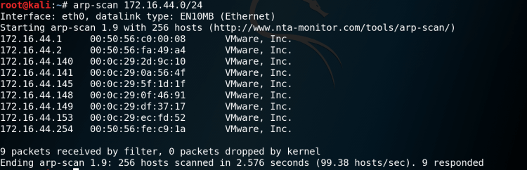
MAC Address Scanning – apr-scan
Scans a subnet for all IP addresses to determine their MAC addresses. Uses ARP requests.

Slide 10
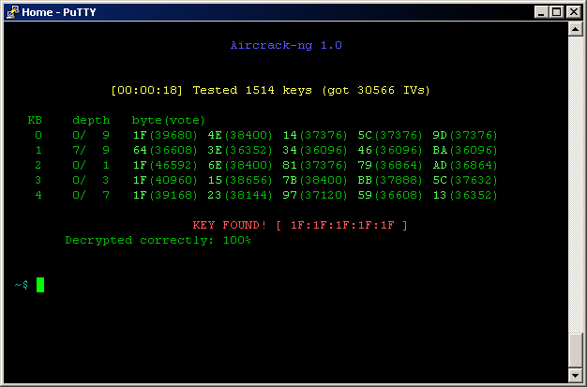
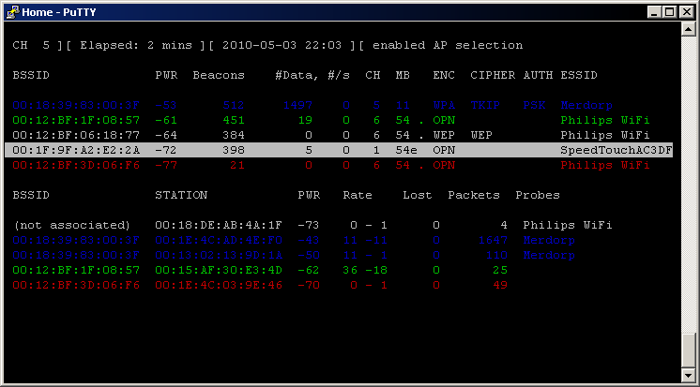
Aircrack – NG
Turns the wifi card to promiscuous mode and aids
Packet capturing and analysis.
Cracking WEP and WPA/WPA2-PSK keys.

Slide 11
Discovering nearby networks
# airodump wlan0
CH 9 ][ Elapsed: 1 min ][ 2007-04-26 17:41 ][ WPA handshake: 00:14:6C:7E:40:80
BSSID PWR RXQ Beacons #Data, #/s CH MB ENC CIPHER AUTH ESSID
00:09:5B:1C:AA:1D 11 16 10 0 0 11 54. OPN NETGEAR
00:14:6C:7A:41:81 34 100 57 14 1 9 11e WEP WEP bigbear
00:14:6C:7E:40:80 32 100 752 73 2 9 54 WPA TKIP PSK teddy
BSSID STATION PWR Rate Lost Packets Probes
00:14:6C:7A:41:81 00:0F:B5:32:31:31 51 36-24 2 14
(not associated) 00:14:A4:3F:8D:13 19 0-0 0 4 mossy
00:14:6C:7A:41:81 00:0C:41:52:D1:D1 -1 36-36 0 5
00:14:6C:7E:40:80 00:0F:B5:FD:FB:C2 35 54-54 0 99 teddy

Slide 12
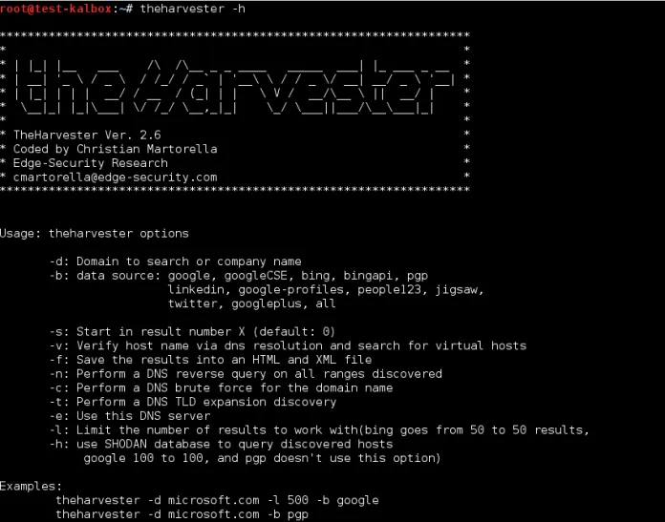
Domain Reconnaissance - theHarvester
Takes input of domain name/emails and looks up all possible subdomains of a given domain, by mining from various sources – google, linkedin, baidu, facebook etc.

Slide 13
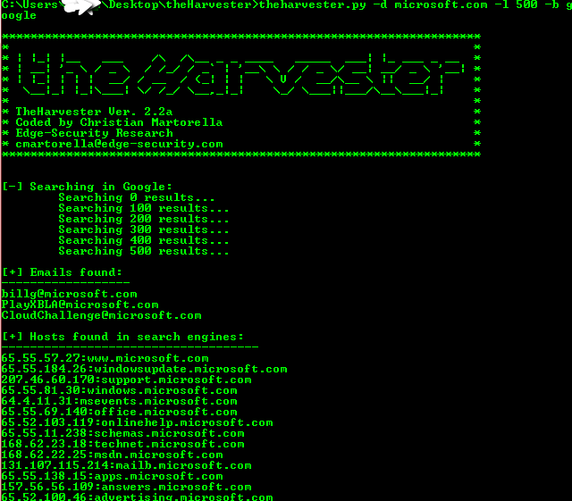
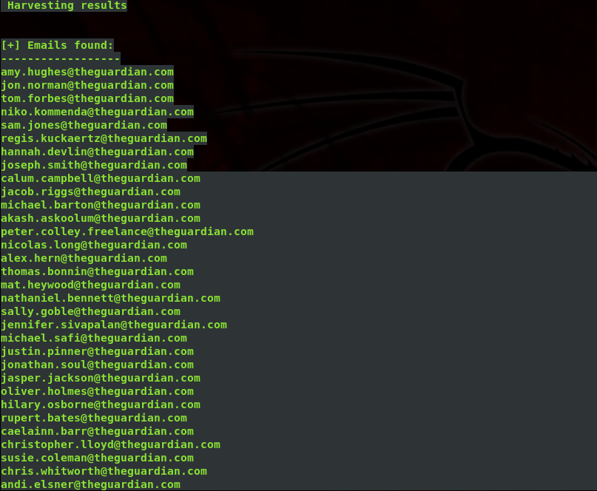
Domain and Email Reconnaissance - theHarvester

Slide 14
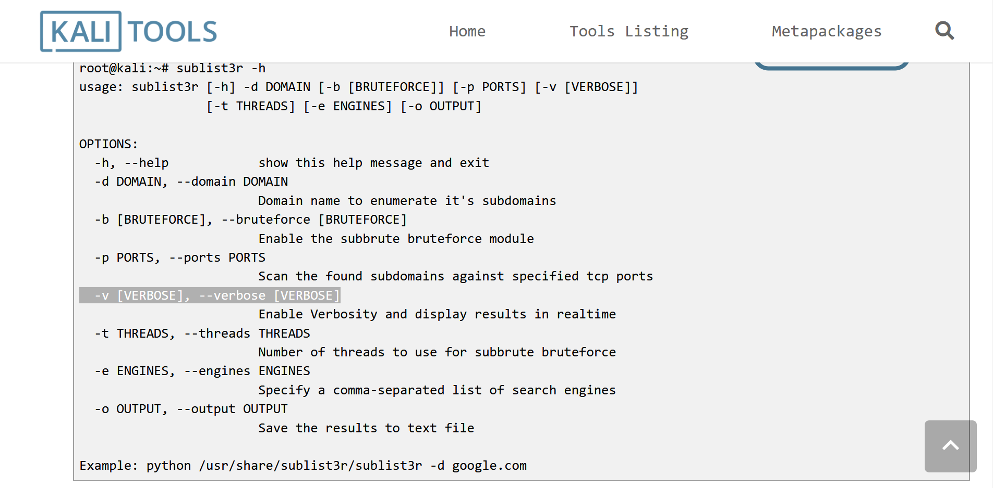
More on Domain Reconnaissance – Sublist3r – focused on Domain Enlisting

Slide 15
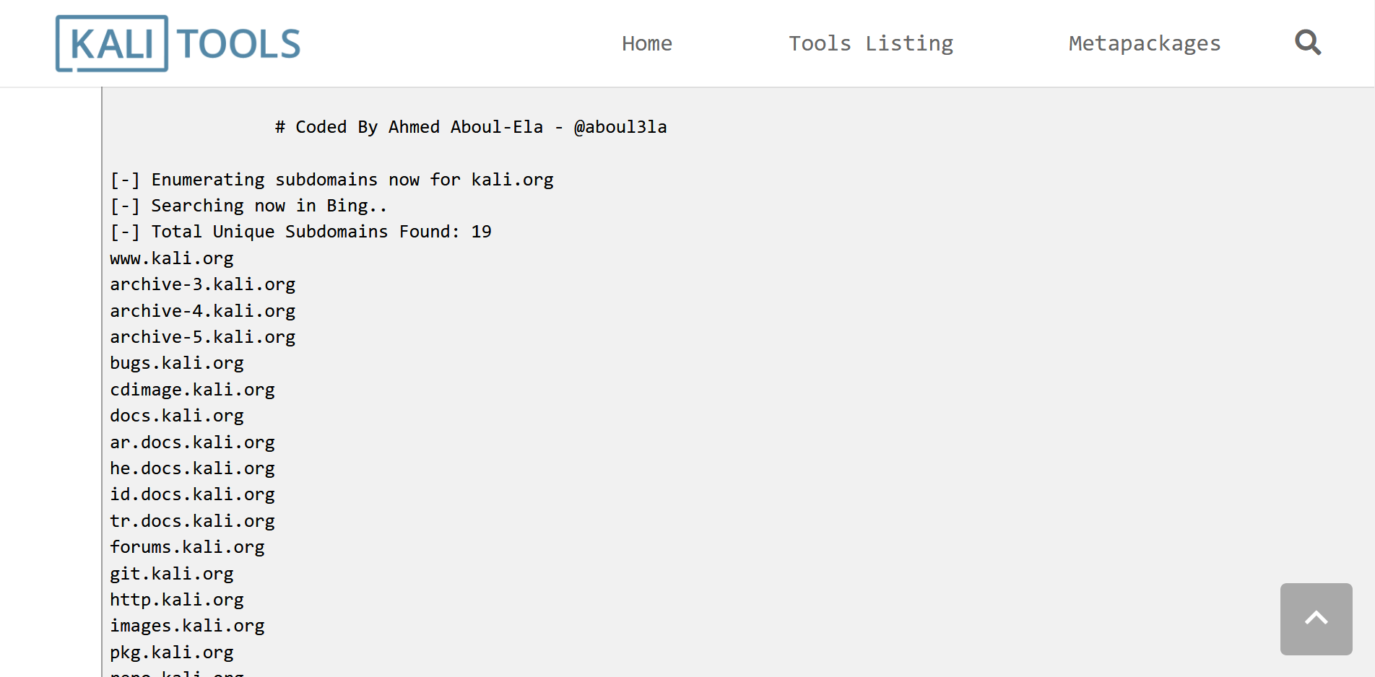
More on Domain Reconnaissance – Sublist3r – focused on Domain Enlisting

Slide 16
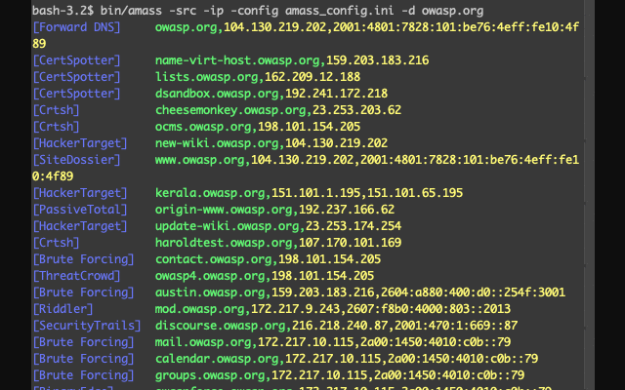
More on Domain Reconnaissance – Amass
Basic functionalities:
DNS: Enumeration, brute forcing, reverse DNS sweep, zone transfers.
Scraping: Baidu, Bing, Google, DNSDumpster, DNSTable, IPv4Info, Yahoo etc.
Certificates: Censys, CertSpotter, Crtsh, Entrust
APIs: AlienVault, BinaryEdge, BufferOver, CIRCL, CommonCrawl, DNSDB, GitHub, HackerTarget, IPToASN, Mnemonic, NetworksDB, PassiveTotal, Pastebin, RADb, Robtex, SecurityTrails, ShadowServer, Shodan, Spyse (CertDB & FindSubdomains), Sublist3rAPI, TeamCymru, ThreatCrowd, Twitter, Umbrella, URLScan, VirusTotal, WhoisXML.

Slide 17
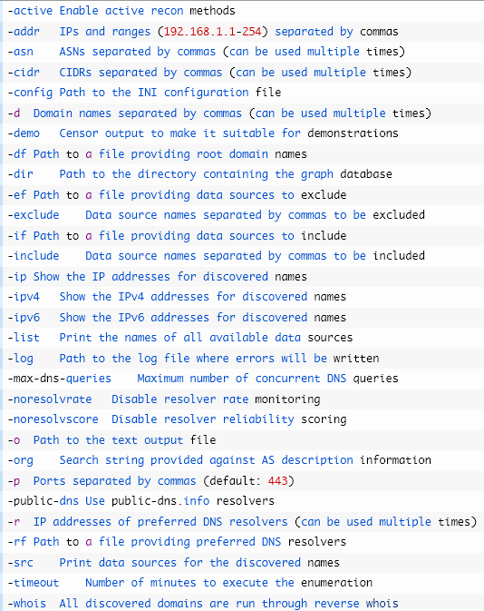
More on Domain Reconnaissance – Amass – Attack Surface Mapping

Slide 18
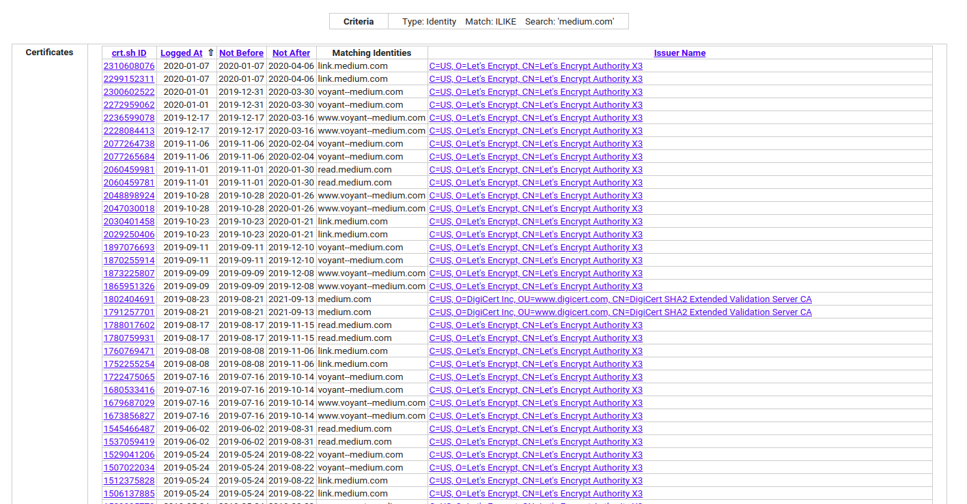
More on Domain Reconnaissance – crt.sh – focused on Domain Enlisting

Slide 19
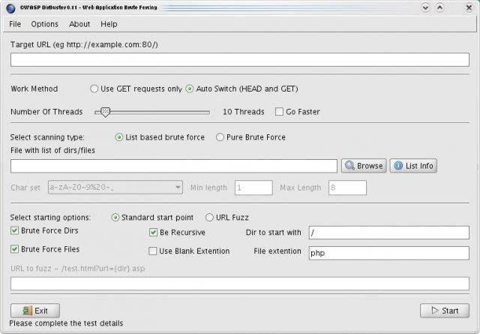
More on Domain Reconnaissance – dirbuster/gobuster – web directory listing

Slide 20
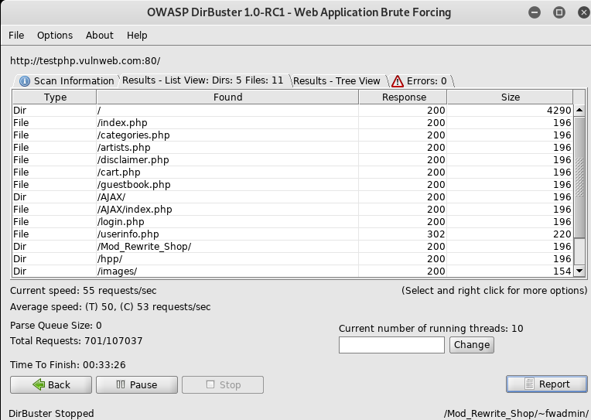
More on Domain Reconnaissance – dirbuster/gobuster – web directory listing

Slide 21
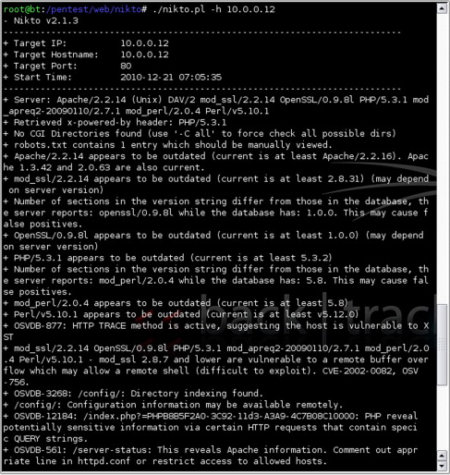
More on Domain/Host Reconnaissance – hosting/server vulnerabilities identifier (nikto)

Slide 22
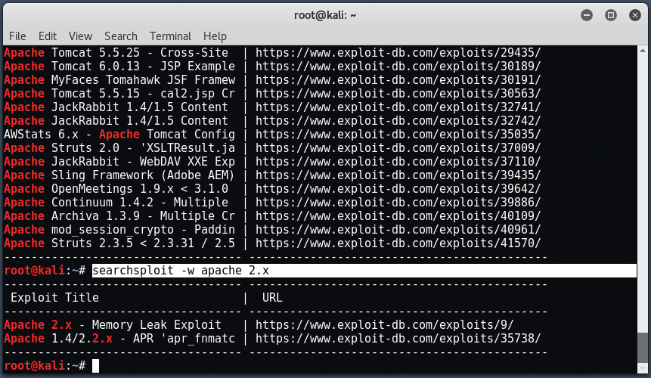
Search for Exploits – seachspoilt(exploit-db)

Slide 23
Basics of Security Audit/Exploitation
Notekeeping – most important task.
Get MAC address and vendor information/card type/capabilities using arp-scan and arping tools for hosts in the same subnet.
Port scanning: Nmap, zmap, mass scan
Open ports, potentially vulnerable services, potential vulnerabilities (i.e. vulnerability scan).
[ you might want to look at censys (zmap) and shodan ]
Domain name enumeration – sublist3r, harvester
More advanced: dnsrecon, dnsenum -- [zone transfers, enumerate domains and record types, brute force domain names, reverse DNS lookups, enumerate subdomains via google]
Directory scanning – nikto, dirb/dirbuster.
Search vulnerability – exploit-db, rapid7, securityfocus, packet storm factory,
Run exploit / code your own / rely on systems like msfconsole (metasploit).
Cover your tracks – ideally delete the various system logs -- /var/log/syslog, /var/log/httpd-access.log / /var/log/httpd-error.log , /var/log/auth.log, /var/run/utmp, /var/run/wtmp, /var/run/btmp.

Slide 24
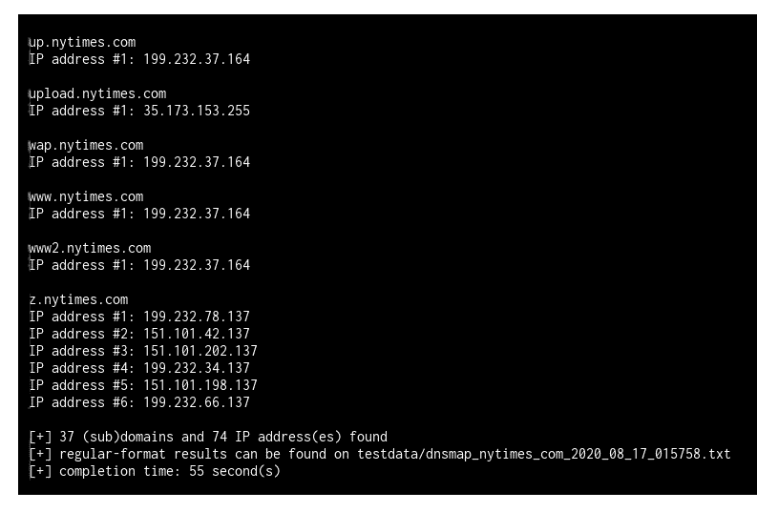
DNSMap
Purpose and benefits for attackers:
- DNS enumeration. Relies on several open-source sites (OSINT sites) – google, baidu, linkedin etc.
- Can be used to also scan with a given wordlist (for bruteforcing the DNS).

Slide 25
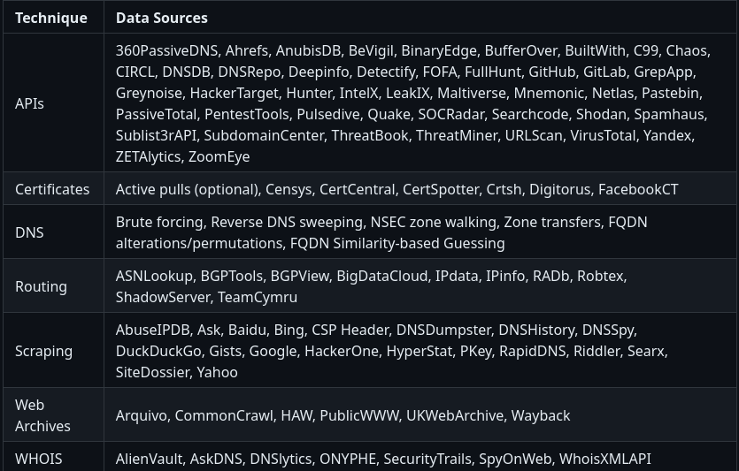
OWASP-Amass
Purpose and benefits for attackers:
- Slow, yet does pretty much everything that the existing tools can do.

Slide 26
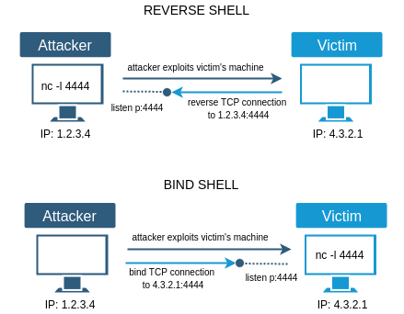
Msfconsole
Various easy to pick and choose vulnerability assessment tools – reconnaissance, enumeration, exploits specific to platform and program versions (e.g. Apache x.y exploit for Linux 2.6.31).
Exploits: Abuse of the vulnerabilities on the systems under test.
Buffer overflow attacks – aka injecting shellcodes, injecting bind shell and reverse shell.
Buffer overflow – Programs take inputs from files/stdin/socket. These inputs may change the program stack and thus the return address.
Inject programs that listen on IP:Ports or connect back (like what Trojans/Malware do).
Other exploits e.g. SQL Injection, invalid or malicious arguments to be passed to webservers, etc. – tool of choice is Burpsuite, Nessus

Slide 27
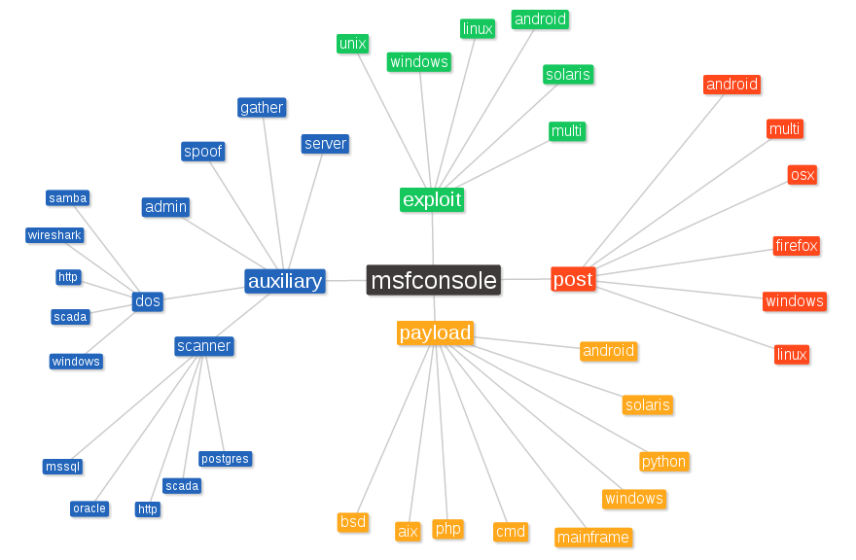
Msfconsole: Organization

